Slide 1
Software Measurement Presentation Team - H Meet Patel 40071820 Haifeng Wu 40102956 Basant Gera 40082433 Sandeep Kaur Ranote 40089795 Sourabh Rajeev Badagandi 40098471 Submitted to : Dr Jinqiu Yang

Slide 2
CONTENTS
 | SELECTED PROJECTS | 3
 | DIFFICULTIES FACED | 4
 | METRICS CALCULATED | 5
 | STATEMENT COVERAGE : METRIC 1 | 6
 | MUTATION TESTING : METRIC 3 | 7
 | PACKAGE INSTABILITY: METRIC 5 | 8
 | POST DEFECT DENSITY: METRIC 6 | 9
 | RELATED WORK | 10
 | CORRELATION BETWEEN METRIC | 11
 | REFERENCES | 17

Slide 3



SELECTED PROJECTS
01
Apache Common Collections
(4.4) [67k].
02
Apache Common Lang
(3.9) [80k].
03
Alibaba Fastjson
(1.2.67) [193k]
04
Apache Common Configuration
(2.6) [932k]
5

Slide 4





DIFFICULTIES FACED
GETTING PROJECTS BUILD ON ECLIPSE
Faced several issue regarding maven version conflicts & Eclipse version. Many Release was quite old due to which there were conflicts.
We have used Neon Eclipse & IntelliJ latest Version to build the projects with latest jdk & Jre but many a times the projects are not building because the versions.
Once set up was done, next steps were quite simple to gather data.
Adding dependency in pom.xml
Run goal or build maven
Since it was open source projects it took us several days to build the project in eclipse.

Slide 5

METRICS MEASURED
1. Statement Coverage
6. Post Release Defect Density
2.Branch Coverage
3.Test Suite Effectiveness (Mutation Testing)/Mutation
Score
5. Package Instability
4. McCabe Complexity

Slide 6
Statement Coverage: Metric 1
Definition:
Statement coverage is a white box technique, it is a measure of number of statements that will be executed in the code base when the system is run.
It can be defined mathematically as :
It helps to identify:
Dead Code
Unused Statements
Unused Branches
Missed Statements

Slide 7
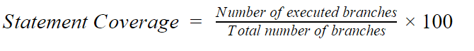
Branch Coverage: Metric 2
Definition:
Branch coverage is a white box technique, it is a measure of decision branches executed and verified out of all the branches present in the system.
It can be defined mathematically as :
Advantages:
Helps to validate all branches in the code.
Helps to identify branches that are not validated by existing test cases.
Helps to overcome the shortcomings of statement coverage testing.

Slide 8
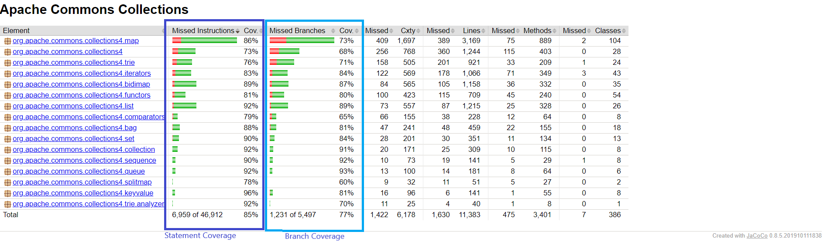
Metric 1 and Metric 2 measurement tool : Jacoco
Statement coverage(Metric 1) and Branch coverage(Metric 2) are measured using Jacoco.
Both the metrics are part of code coverage metric that highlights what we haven’t definitely tested, rather than what we have tested.

Slide 9
WHY JACOCO ?
WHAT IS JACOCO
Because It is used in number of researches and also in industry to continually monitor code coverage.
JaCoCo is a free code coverage library for Java, which has been created by the EclEmma team based on the lessons learned from using and integration existing libraries for many years. [1]
WHY JACOCO ?
JaCoCo Provides reports in both HTML and CSV.
It measures code coverage (statement, instruction and branch coverage) and also calculates McCabe Complexity for the methods and classes respectively.

Slide 10
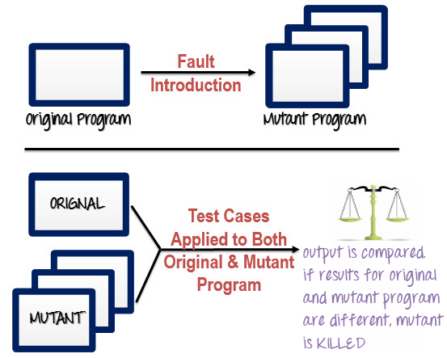
MUTATION TESTING : METRIC 3
Mutation testing is type of white box testing which involves mutating(changing) certain statements to check if the test cases are able to find the errors.
The goal is to assess the quality of the test code, which should be capable of catching the mutated code.
https://www.guru99.com/mutation-testing.html

Slide 11
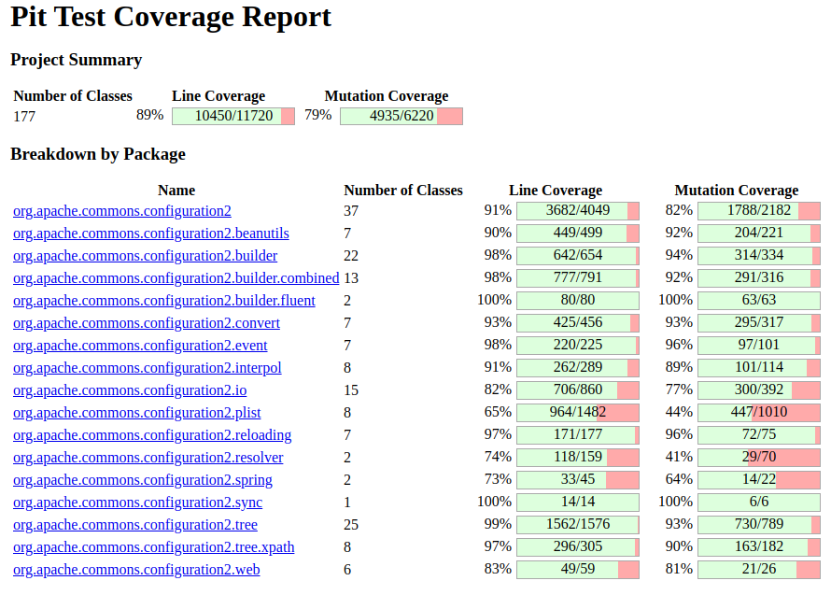
MUTATION TESTING : METRIC 3
Mutation Testing : Metric 3
We used PI Test[4] to perform mutation testing on selected projects considering it community support and robustness.
Steps :
Adding dependency in pom.xml
Executing goal
Or Installed PIT Mutation score plugin via eclipse and did run as PIT Mutation score.

Slide 12
Cyclomatic Complexity: Metric 4
Cyclomatic Complexity is a software metric used to measure the complexity of a program. It is a quantitative measure of independent paths in the source code of the program.
If the decision points are more, then complexity of the program is more. If program has high complexity number, then probability of error is high with increased time for maintenance and troubleshooting.
Provides information about:
Level of coupling.
Ease of understanding the code.
Ease of testing the code.

Slide 13
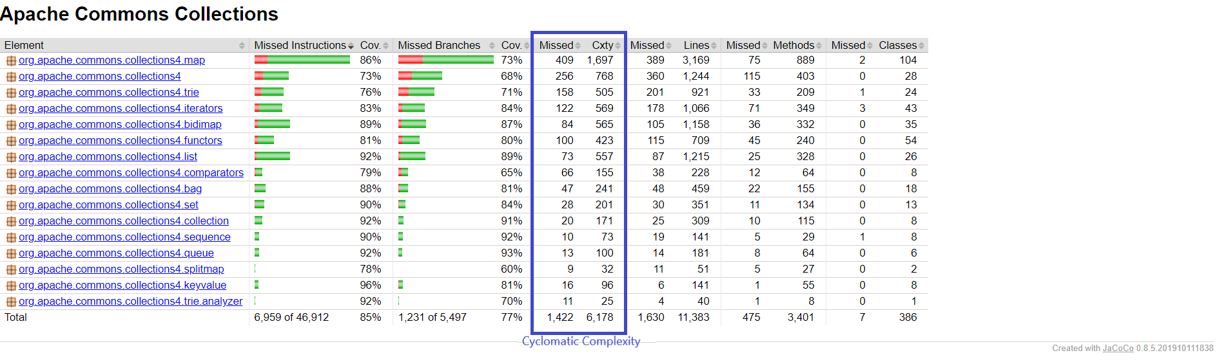
Metric 4 measurement tool: Jacoco
Jacoco is used to get Cyclomatic Complexity results.

Slide 14
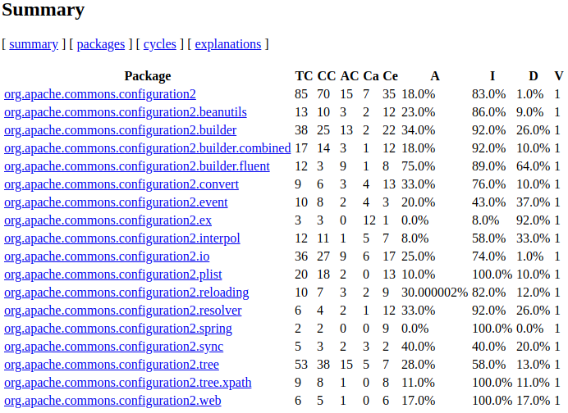
PACKAGE INSTABILITY : METRIC 5
Package Instability
: Metric 5
Tool Used : JDepend
JDepend traverses Java class and source file directories and generates design quality metrics for each Java package. JDepend allows you to automatically measure the quality of a design in terms of its extensibility, reusability, and maintainability to effectively manage and control package dependencies.[2]

Slide 15
POST RELEASE DEFECT DENSITY: METRIC 6
Defect Density: Metric 6
Post Release Defect Density = Defect count(No of bugs)/size of the release(KLOC)
How did we calculate it?
Calculating No of Bugs from Issue Tracker(JIRA in our case) via query.
Dividing it by LOC(only java line of code is taken)
How did we calculate LOC?
We found very accurate and handy tool to calculate rather than directly calculating LOC from every file that resides in source folder. Some of the file may not be actually related to program, such as author list and pull request template.
That’s why we chose CLOC[3]:

Slide 16
CORRELATION BETWEEN METRIC

Slide 17
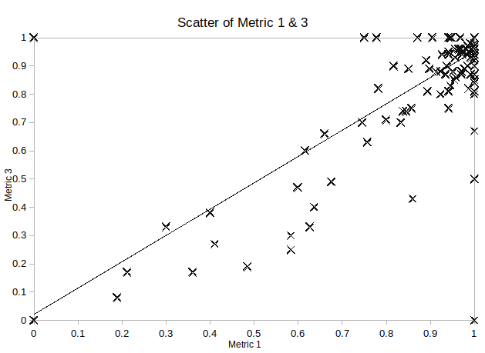
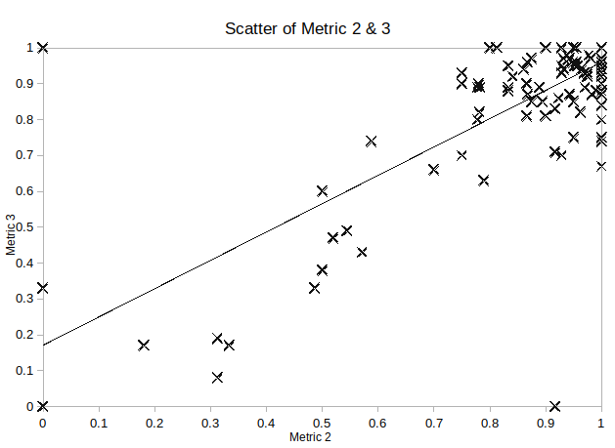
CORRELATION BETWEEN CODE COVERAGE AND MUTATION SCORE
Correlation between Statement Coverage and Mutation Score
Pearson = 0.822101141237296
Correlation between Branch Coverage and Mutation Score
Pearson =0.753624103674882
Notes:
Why we chose Spearman over pearson? Because software data are not normalized generally, Also known as grade correlation.
Our hypothesis

Slide 18
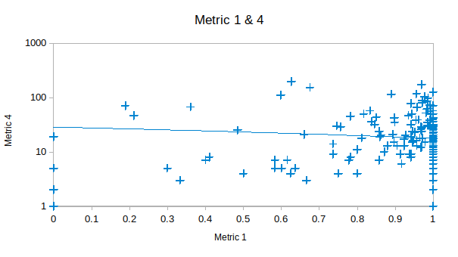
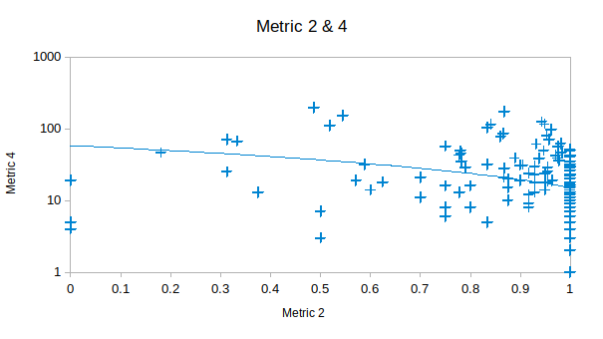
CORRELATION BETWEEN CODE COVERAGE AND MCCABE COMPLEXITY
Correlation between Statement Coverage and McCabe Complexity
Pearson = -0.080450354386607
Correlation between Branch Coverage and McCabe Complexity
Pearson = -0.264964262554222
Notes:
We found 1 paper,
Persson, S. (2015). The correlation between code coverage, cyclomatic complexity and fault frequency. DIVA. Retrieved 3 April 2019, from http://www.diva-portal.org/smash/record.jsf?pid=diva2%3A826710&dswid=-4763
We have found that there is little to no correlation between metrics for code coverage and
software faults. We have also found that there is no correlation what so ever between
cyclomatic complexity and software faults Therefore we can conclude there is no correlation or
very correlation between code coverage and code complexity.

Slide 19
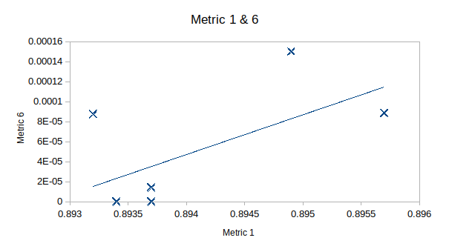
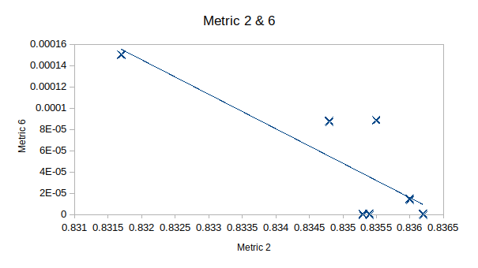
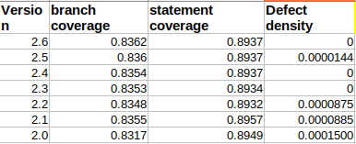
CORRELATION BETWEEN CODE COVERAGE AND DEFECT DENSITY
Correlation between Statement Coverage and Defect Density
Pearson = 0.6000434903449
Spearman= 0.5
Correlation between Branch Coverage and Defect Density
Pearson = -0.819525324677979
Spearman=-0.481812055829716
Notes:
Negative Correlation

Slide 20
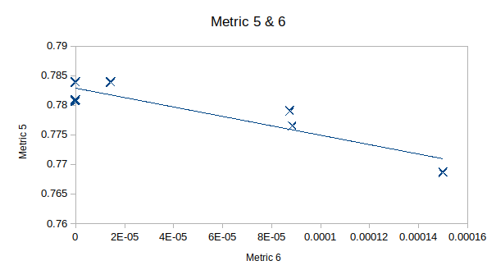
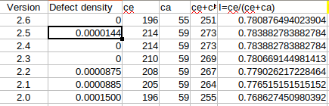
CORRELATION BETWEEN PACKAGE INSTABILITY AND POST DEFECT DENSITY
Correlation between package Instability & Post defect density
Pearson = -0.906196661351723
Spearman = -0.705

Slide 21
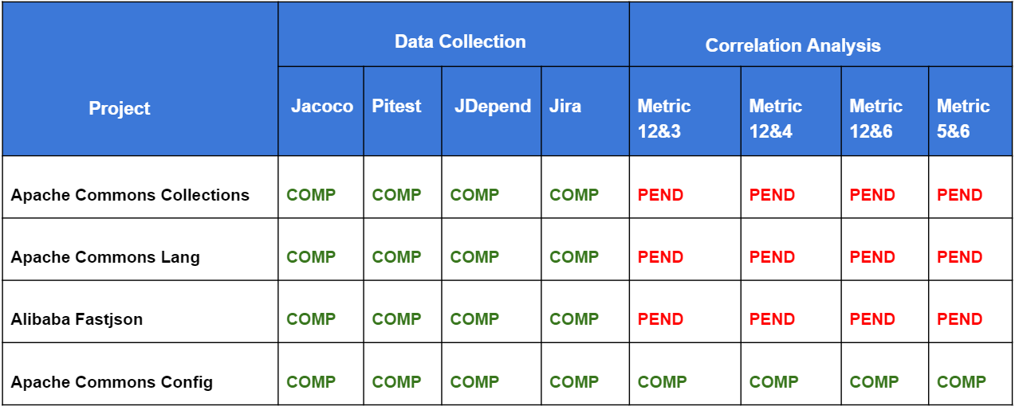
WHAT WE HAVE DONE SO FAR
Github URL : https://github.com/sourabh-rb/SOEN6611

Slide 22
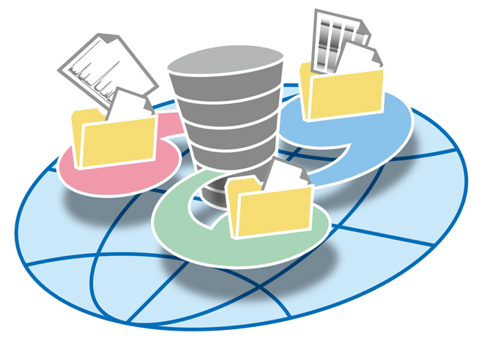

REPOSITORY AND DATA ANALYSIS PROCEDURE

Slide 23

REFERENCES
1. EclEmma - JaCoCo Java Code Coverage Library. (2019). Eclemma.org. Retrieved 1 April 2019, from https://www.eclemma.org/jacoco
2. Jdepend – Tool to measure Metric 5 http://www.testingtoolsguide.net/tools/jdepend/
3. CLOC -- Count Lines of Code. (2019). Cloc.sourceforge.net. Retrieved 1 April 2019, from http://cloc.sourceforge.net/
4. PIT Mutation Testing. (2019). Pitest.org. Retrieved 2 March 2019, from http://pitest.org/

Slide 24
THANK YOU

